Slide 1
Intro to Azure Stuff
Alex Patin
Student Partner | Microsoft
Alexander.Patin@studentpartner.com

Slide 2







client/server
device/services
Notes:
Developers can be roughly subdivided into two distinct camps: 1.) developers writing apps against the existing, client/server application pattern, and 2.) developers writing apps against the emerging, device/services application pattern.
The existing app pattern is line-of-business (LOB) apps, forms over data, and web implementations of this are generally static pages
The new app pattern is either device-first, in which you have a multi-device, multi-screen experience, that takes a cloud service dependency, or cloud-first, in which the core asset is a cloud service which surfaces as an experience on a device (or multiple devices).

Slide 3
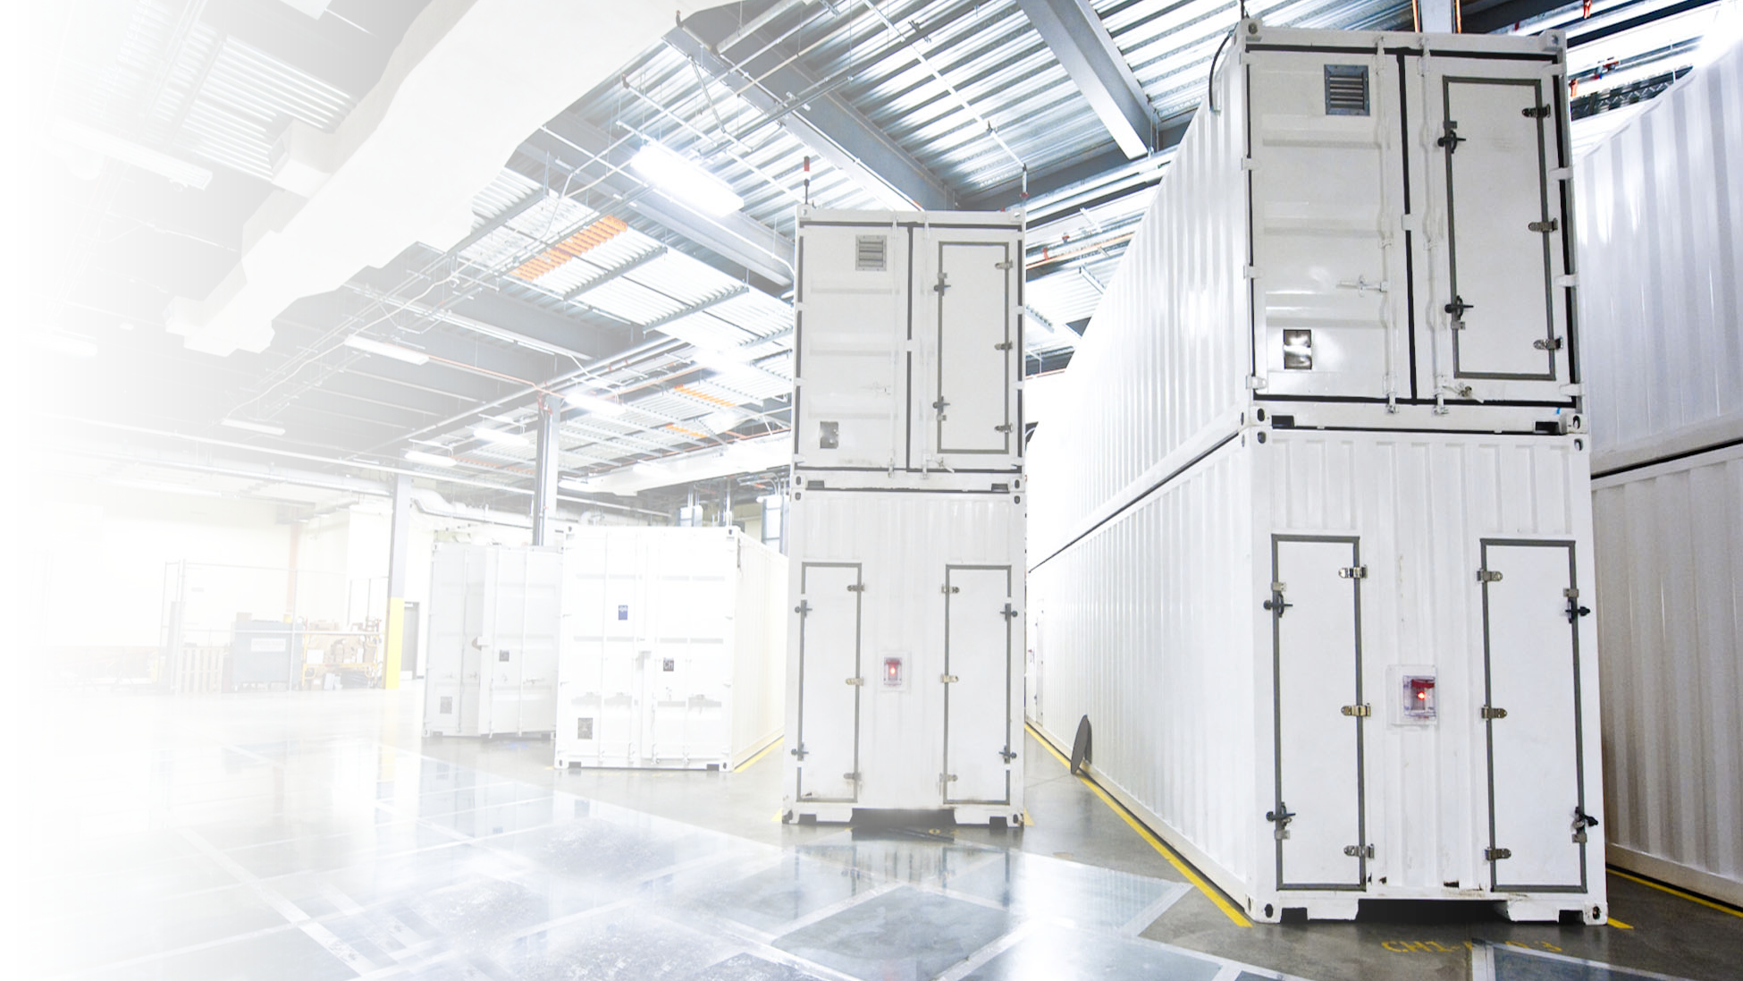


Windows in the cloud
Notes:
For Microsoft, the runtime for the cloud OS is a set of capabilities that will enable development against the cloud design point and new app patterns. It’s comprised of a core set of capabilities such as virtual machines, websites, and media & mobile services that developers can extend through higher level services such as identity, data, and integration. In addition, application/SaaS-level extensibility also enables an increasingly relevant class of apps, especially for business application developers. As developers shift toward the emerging app pattern, this portfolio of capabilities will become the baseline set of requirements, and only Microsoft has this portfolio today.

Slide 4
public
cloud
.NET
Hyper-V
Visual Studio
System Center
Active Directory
hybrid cloud
private cloud
Notes:
Key Points:
Windows is our platform for both devices and services, server and cloud
Common thread across all of Windows – PC, Tablet, Phone, Server, Cloud, Data – It is all Windows
What we learn from hosting some of the largest services in the world we implement in our products.

Slide 5





Industry Cloud Models
“IaaS”
“PaaS”
“SaaS”
Infrastructure-as-a-Service
Platform-as-a-Service
Software-as-a-Service
host
build
consume
yy

Slide 6
Programming Model + Tools
Identity
Integration
Data
IaaS + PaaS
Microsoft Cloud Infrastructure
Notes:
We're building a very robust Windows Azure app model.
At the bottom of the app model is our infrastructure. Datacenters. Edge network. At the compute-storage-network level, at the datacenter scale and multi-datacenter scale. And that really is the operating system that is Windows at the backend, at this point, which in fact shipped even in Windows Server for a different scale unit.
Application containers. And we're unique in providing a complete IaaS plus PaaS, which is infrastructure as a service and platform as a service capability when it comes to application containers. Everything from virtual machines with full persistence to websites to mobile to media services to cloud services. So that capability is what allows you to build these rich applications and very capable applications.
Beyond that, we also believe that we can completely change the economics of what complex applications have needed in the past. We can take both productivity around development and continuous deployment and cycling through your code of any complex application and reduce it by orders of magnitude.
Take identity. We are going to change the nature of how people set up your applications to be able to accept multiple identities, have strong authentication and authorization, how to have a directory with rich people schema underneath it that you can use for authorization.
Integration, take all of the complex business-to-business or EI type of project that you have to write a lot of setup before you even write the core logic; we want to change the very nature of how you go about that with our integration services.
And when it comes to data, there is not a single application now that doesn't have a diverse set of needs when it comes to the data from everything from SQL to NoSQL, all types of processing from transactional to streaming to interactive BI to MapReduce. And we have a full portfolio of storage technologies all provided as platform services so that your application development can be that much richer and that much easier.
Now, obviously, the story will not be complete without great tooling and great programming model.

Slide 7








●
Open Platform

Slide 8
Azure Web Apps

Slide 9

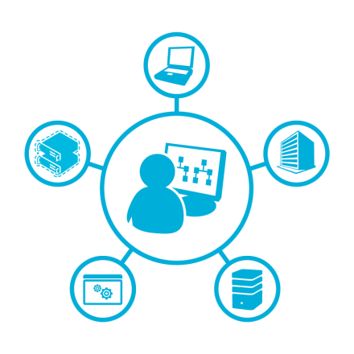

Azure Web Apps
Scalable
Automated
Flexible
High-density and secure web hosting
Open publishing methods and protocols
Integrated and open solution
Lowers customer onboarding costs and streamlines upselling
Upsell from shared to reserved
Support for PHP, Node.js, and ASP.NET
Metering and throttling of resources
Fully integrated into Web App Gallery
Notes:
Web Sites is a highly scalable web hosting service for public and private clouds that is optimized for cloud hosting economics and integrated with the world’s most popular OSS Web apps, frameworks and tools.
Create high-density, scalable website hosting services that are simple to deploy and administer, operating tens of thousands of sites in a single web farm.
Out-of-the-box automation lowers customer onboarding costs while resource metering and throttling can help tailor customer offerings.
Supports many frameworks including ASP.NET, Classic ASP, PHP, and Node.js with full Git integration for source code control. Integration of the Web App Gallery allows customers access to popular web applications.

Slide 10

Evolving from machine-centric to distributed
Traditional machine-centric model
Distributed model
With multiple web applications, challenges for service providers include:
Increased load and management complexities
Security - Isolating stored data, authentication & authorization mechanisms
Scaling - Auto-scaling platform compute, scaling platform storage
Web Sites allocates a web application to a specific process:
Distributes load by allocating web applications to specific processes
Provides a scalable and elastic resource pool capable of running an arbitrary set of web applications
Worker process
Web
application
Web application content
Web application content
Internet Information Services web server
applicationHost.config
root web.config
Php.ini
applicationHost.config
root web.config
Php.ini
Application databases
Application databases
Notes:
Traditional web server environment
The primary challenge hosters have found with our web app architecture to date is that in this model, applications have an affinity to just a single server and this can cause a lot of problems for a large scale, multitenant web farm. A typical web application consists of application content stored in a file directory, one or more application databases, and configuration metadata required by the web server. This model works well for a relatively small number of web applications. Developers and administrators can easily keep track of a handful of web applications and ensure that various external resources and supporting configuration data stay in sync.
However this model quickly becomes unwieldy as the number of web applications running in a single environment increases:
There is an effective limit beyond which new web servers, file servers, and database servers are required to support increased load and increased numbers of web applications.
As the number of web applications and the amount of underlying hardware and virtual machines increases, management complexity skyrockets.
While a machine-centric model can be simple to administer when the number of web applications is very low (for example, numbering in the tens of applications), managing hundreds of web applications can quickly become unwieldy. If the number of web applications increases into the low thousands, even traditional command-driven management approaches optimized for bulk application management become difficult to scale and maintain.
As you increase the number of web applications even further to tens of thousands of web applications running in a single virtual web farm, existing "traditional" web application hosting models simply can't scale.
How Web Sites views a web application
At the most granular level, a cluster allocates a web application to a specific process (or processes).
Instead of configuring a web server to run a given web application, a cluster "configures" a worker process to run a given web application. In the diagram, the web server has been replaced with a worker process.
From the web application's standpoint, nothing has changed. The web application still has read and write file access to its content directories in addition to database access to required database servers. Nothing changes in the web application's code—all of the standard APIs that developers use to gain access to external resources such as files and databases continue to work as expected.
The worker process responsible for running the web application is supplied with all of the standard configuration files required by web applications. For example, settings specific to Internet Information Services are available in an applicationHost.config file that is accessible to the worker process. Similarly, technology-specific settings (such as ASP.NET or PHP) are available from files such as root web.config and php.ini.
Both the web application and the worker process are unaware that they are running on a cluster as opposed to a traditional Internet Information Services web server.

Slide 11



Publishing in Azure Web Apps
Web Sites cluster
Web workers
Server or virtual machine
Local routing logic
Temporary per-
app file storage
End user
Publishers
Worker process
(w3wp)
Persistent storage
Front-end application request router
HTTP/S Request
Web application databases
FTP Service
Web Deploy
Service
…..
Upstream hardware load-balancers
Cluster topology and run-time state
Web application file directories
Publisher services carry out various file operations against a web application's directory structure.
Front-end application request router
Resource usage data
Notes:
Publisher services carry out various file operations against a web application's directory structure.
Publishers authenticate developers and allow to:
Upload/install web application
Modify existing web application
Download copies of web applications.

Slide 12
Go to http://www.dreamspark.com/student
Click Create an Account
Fill in Account information and click “continue to Verify”
Select “I have a Verification code”
Enter the code on the slip

Slide 13
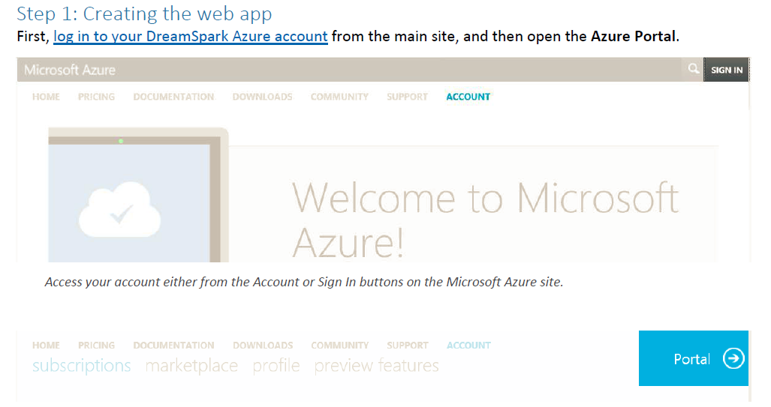

Slide 14
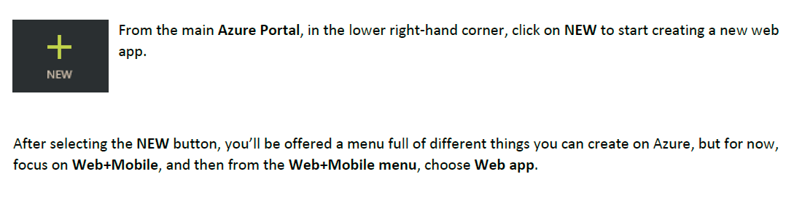
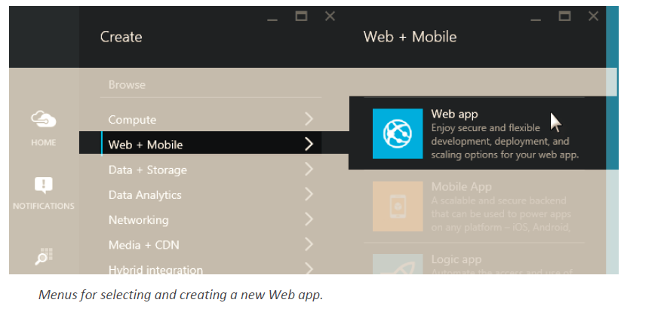

Slide 15
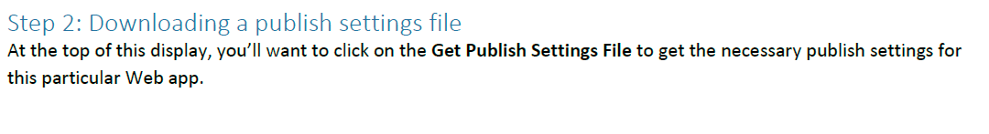
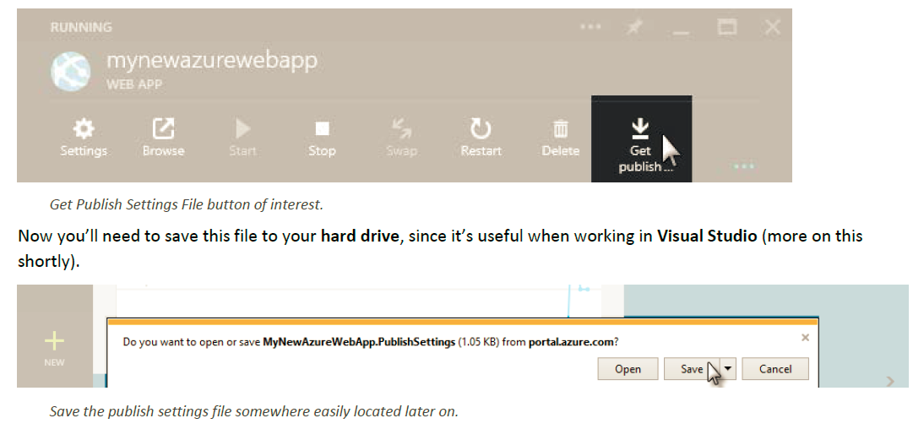

Slide 16
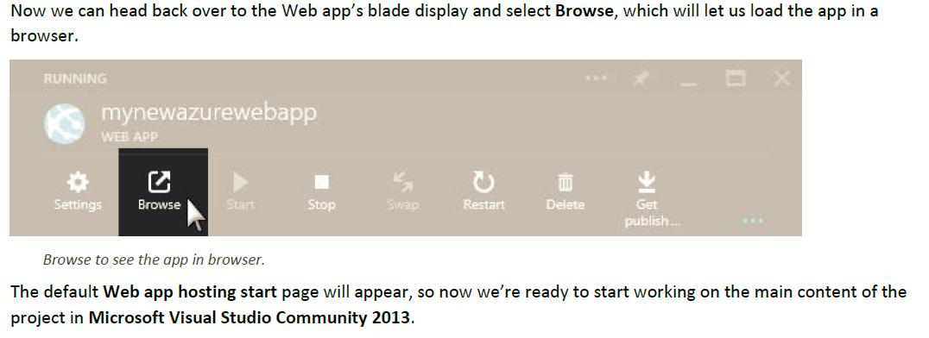

Slide 17
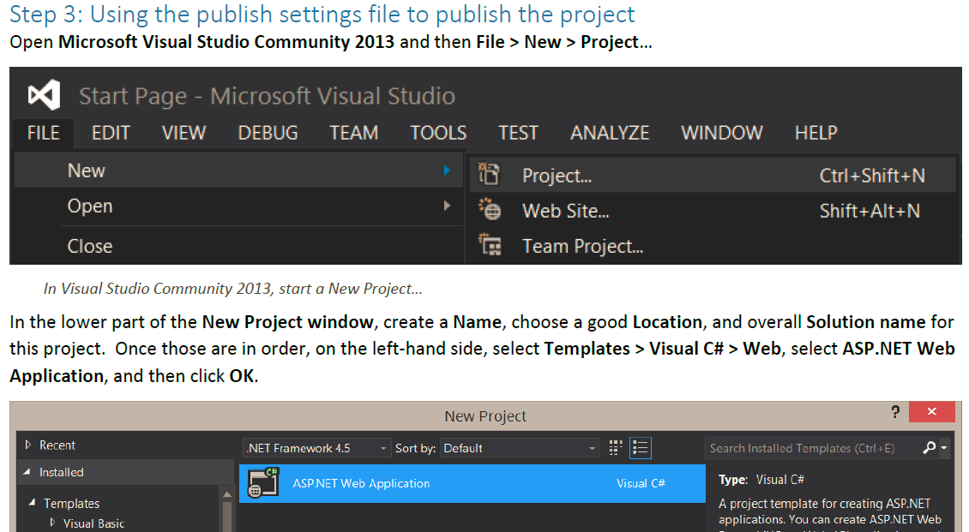

Slide 18
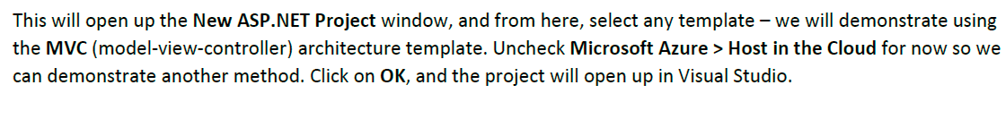
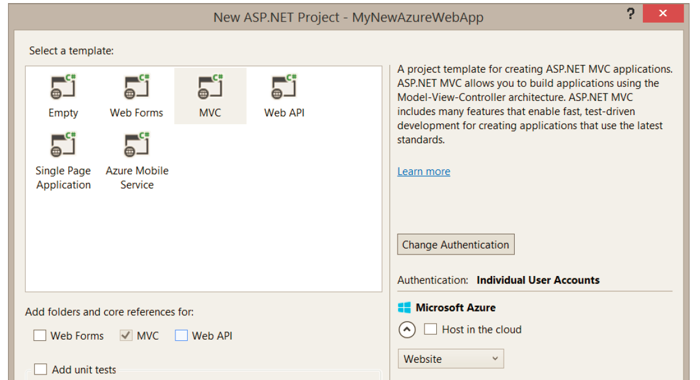

Slide 19
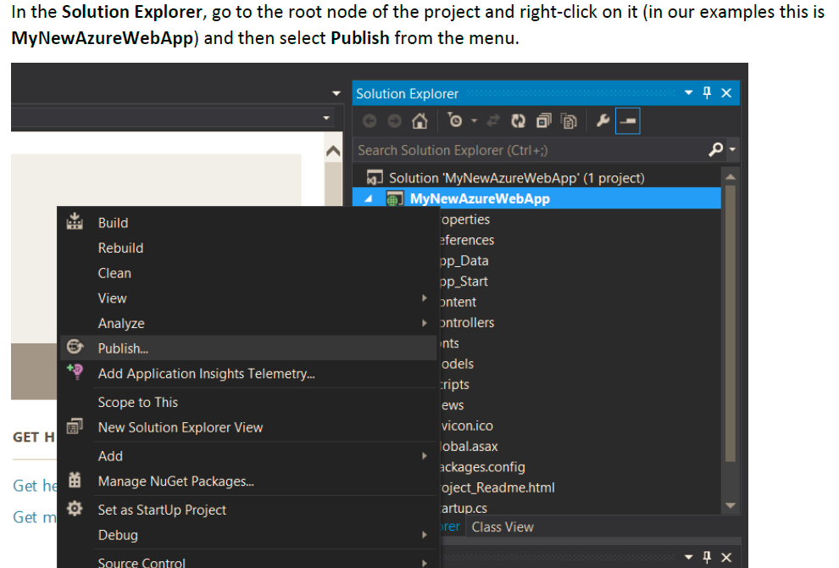

Slide 20
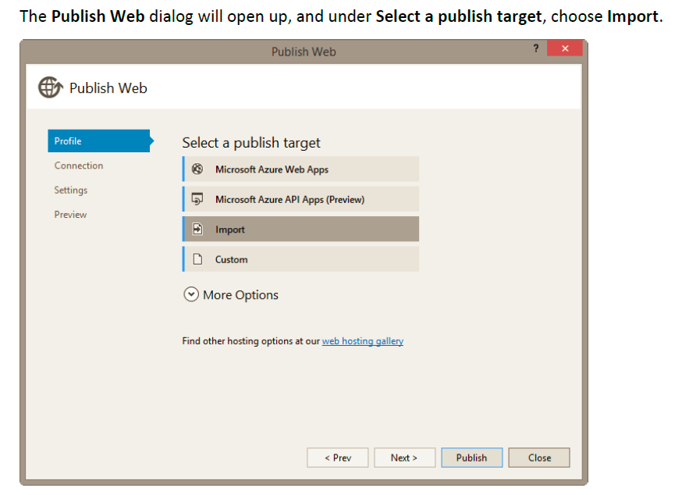

Slide 21
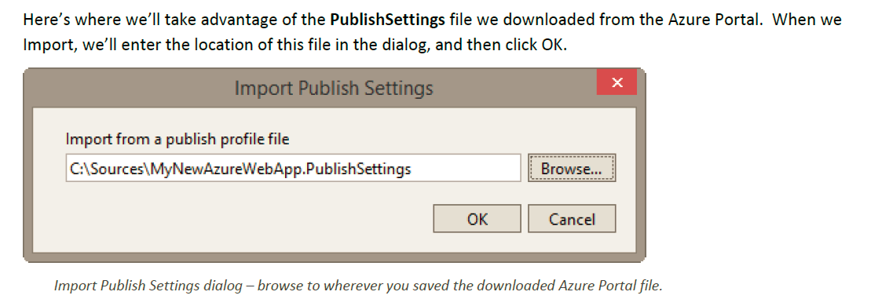

Slide 22
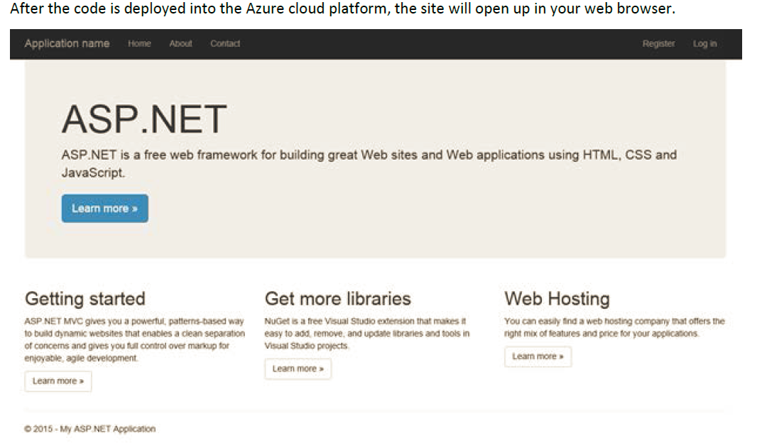

Slide 23
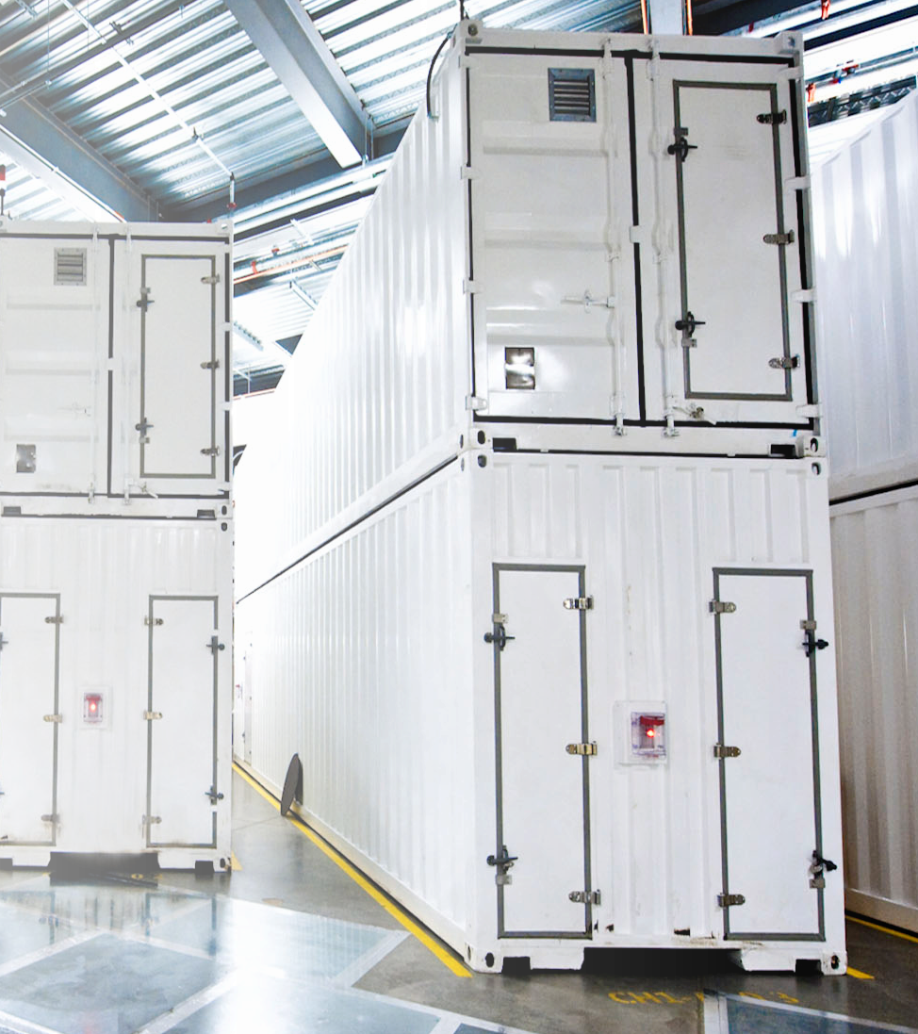
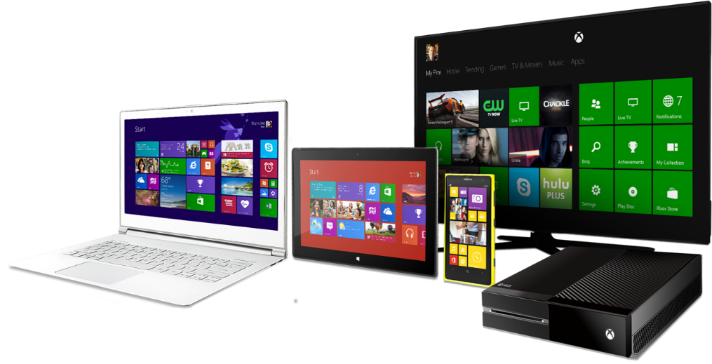
Great device experiences …
… powered by services
in the cloud

Slide 24

Alex Patin
theAlexPatin.com
Alexander.Patin@studentpartner.com
© 2013 Microsoft Corporation. All rights reserved. Microsoft, Windows, Windows Vista and other product names are or may be registered trademarks and/or trademarks in the U.S. and/or other countries.
The information herein is for informational purposes only and represents the current view of Microsoft Corporation as of the date of this presentation. Because Microsoft must respond to changing market conditions, it should not be interpreted to be a commitment on the part of Microsoft, and Microsoft cannot guarantee the accuracy of any information provided after the date of this presentation. MICROSOFT MAKES NO WARRANTIES, EXPRESS, IMPLIED OR STATUTORY, AS TO THE INFORMATION IN THIS PRESENTATION.

